Slide 1
Project Management System
By Mirza Shaheen Iqubal

Slide 2
Project Management System Process Workflow (Scenario)
A manager uses Project Management System created by Power Apps for his/her Employees, Projects and Specific Tasks under projects. He can do following App Operations:
When he assigns task to specific employees, the respective employees gets an email for the task through Automation and Database gets updated and Task information saved on SharePoint List.
Employee:
View Employee List
Add Employees
Delete Employees
Projects:
View Projects List
Add Projects
Delete Projects
Tasks:
View Task List
Add Task
Delete Task

Slide 3





Project Management System Process Workflow
Sharepoint
Database Server
Power Automate
Employee

Slide 4
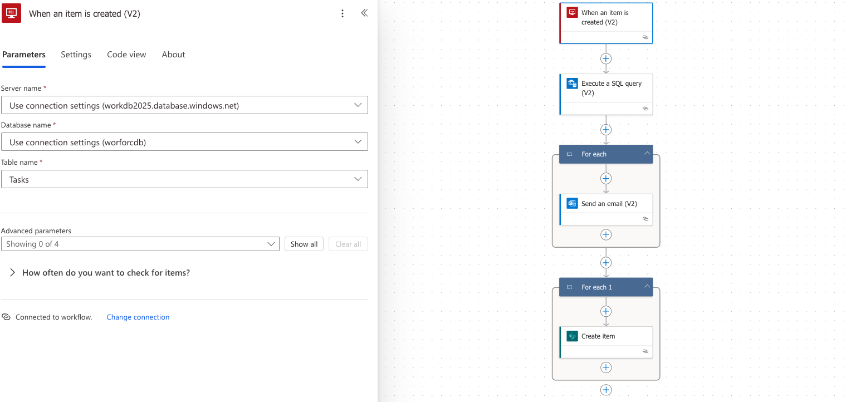
Project Management System Process Workflow (Power Automation)

Slide 5
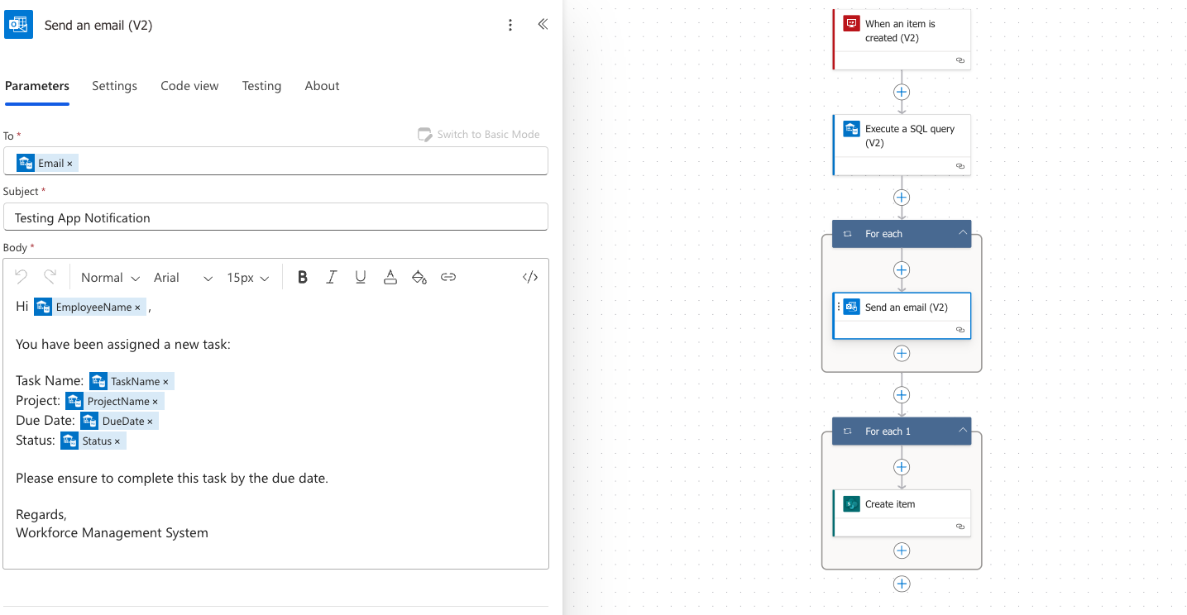
Project Management System Process Workflow (Power Automation)

Slide 6
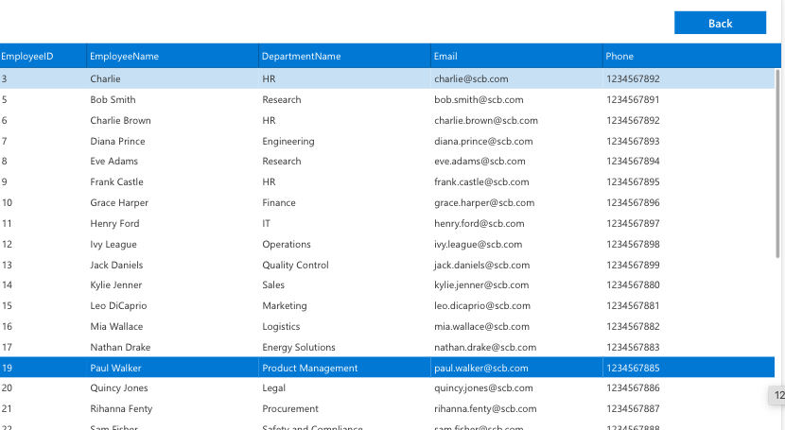
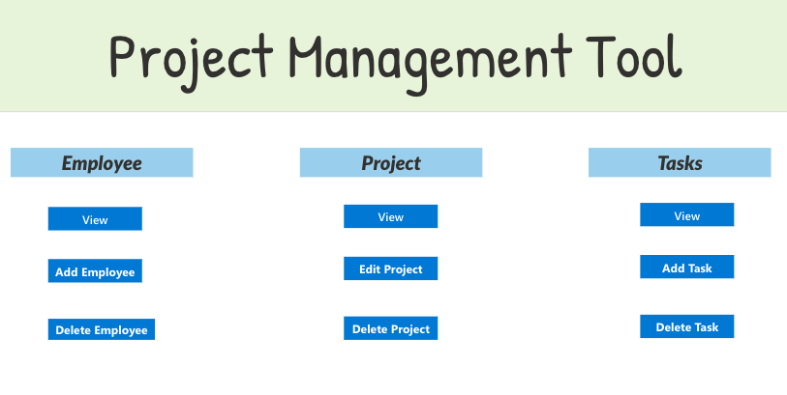
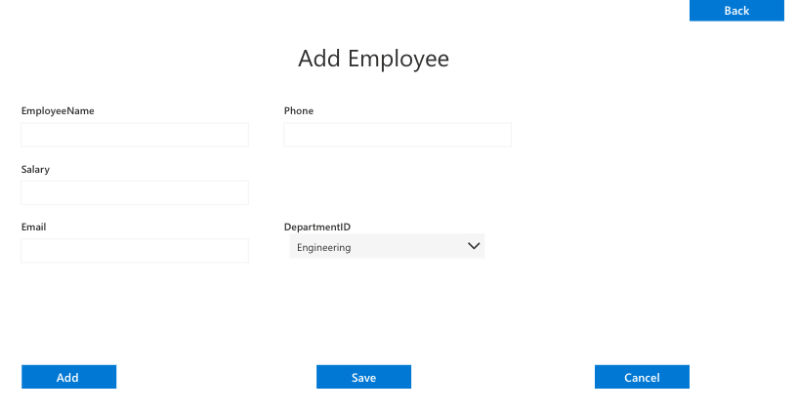
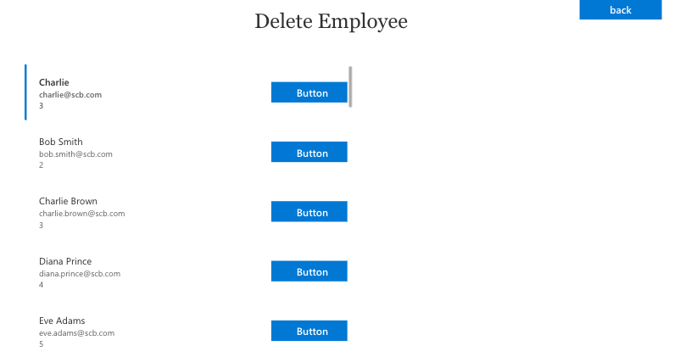
Project Management System Process Workflow (Power Apps)
Home Screen
List Employee
Add Employee
Remove Employee

Slide 7
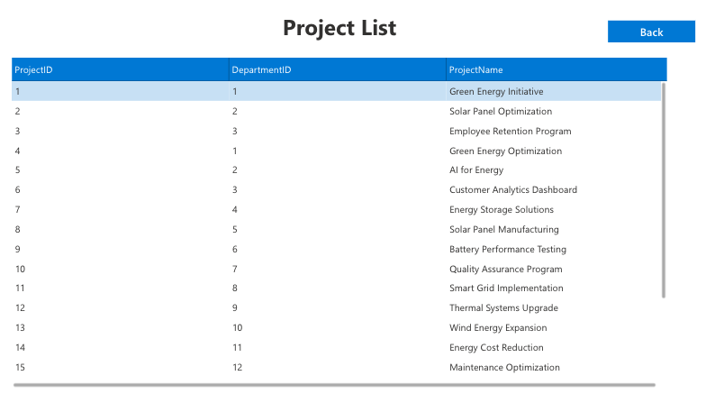
Project Management System Process Workflow (Power Apps)
List Projects

Slide 8
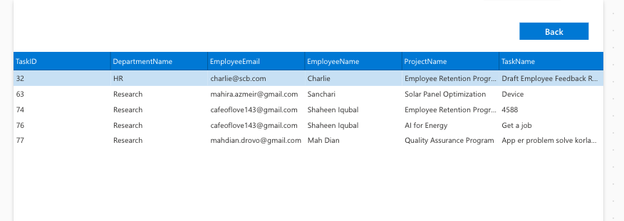
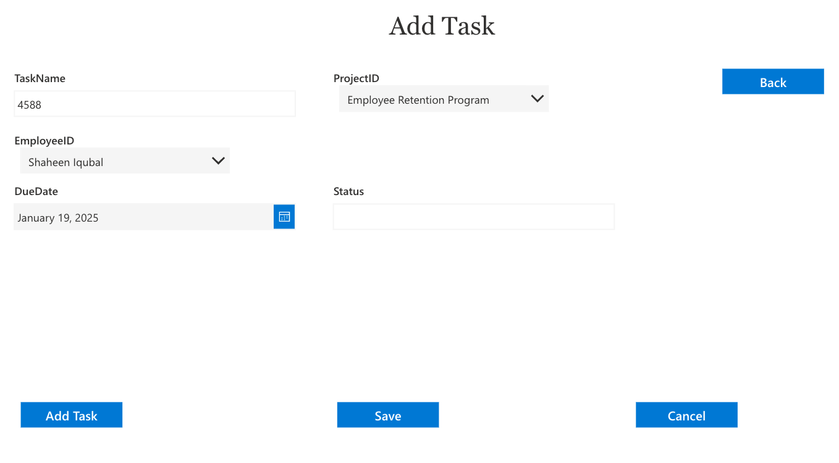
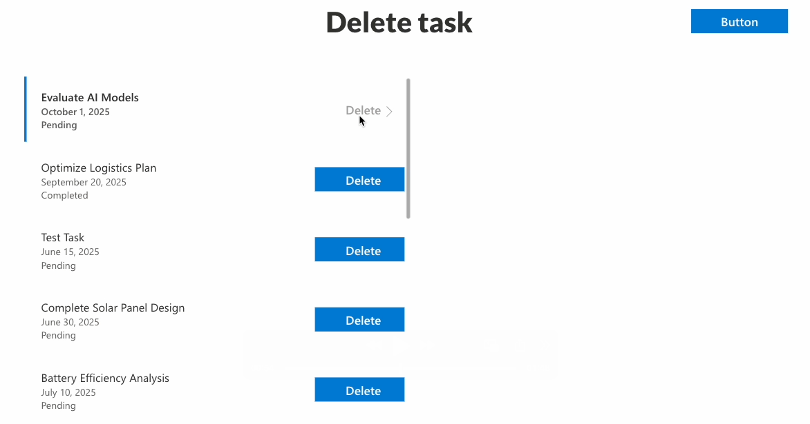
Project Management System Process Workflow (Power Apps)
List Tasks
Add Tasks
Remove Tasks

Slide 9
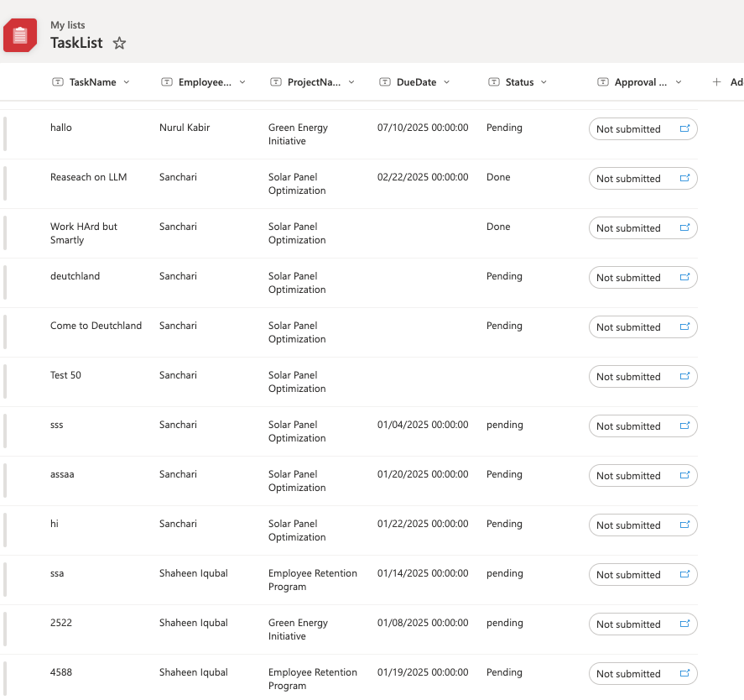
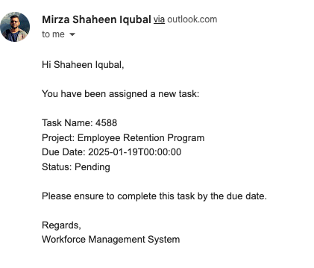
Project Management System Process Workflow (Power Apps)
Automated Email Notification to Employee
Automated SharePoint Task lists is created for manager

